Slide 1

Retail Gig Mobile Application
This presentation provides an overview of a mobile app built using Flutter and Firebase, showcasing how these powerful technologies can be leveraged to create a feature-rich and scalable application.
Presented by:
Ramya Sree Vudugu
Pallavi Padam
Paavani Janapareddy

Slide 2
Project Architecture
Frontend (Flutter)
Backend (Firebase)
Integrated Solution
The app's user interface and core functionality are built using the Flutter framework, leveraging its cross-platform capabilities to deliver a seamless experience on both iOS and Android devices.
The backend is powered by Firebase, a comprehensive app development platform that provides a suite of services including authentication, real-time database, cloud storage, and cloud functions.
Flutter and Firebase work together seamlessly, with the Flutter app interfacing with the various Firebase services to handle user data, authentication, and real-time updates.

Slide 3
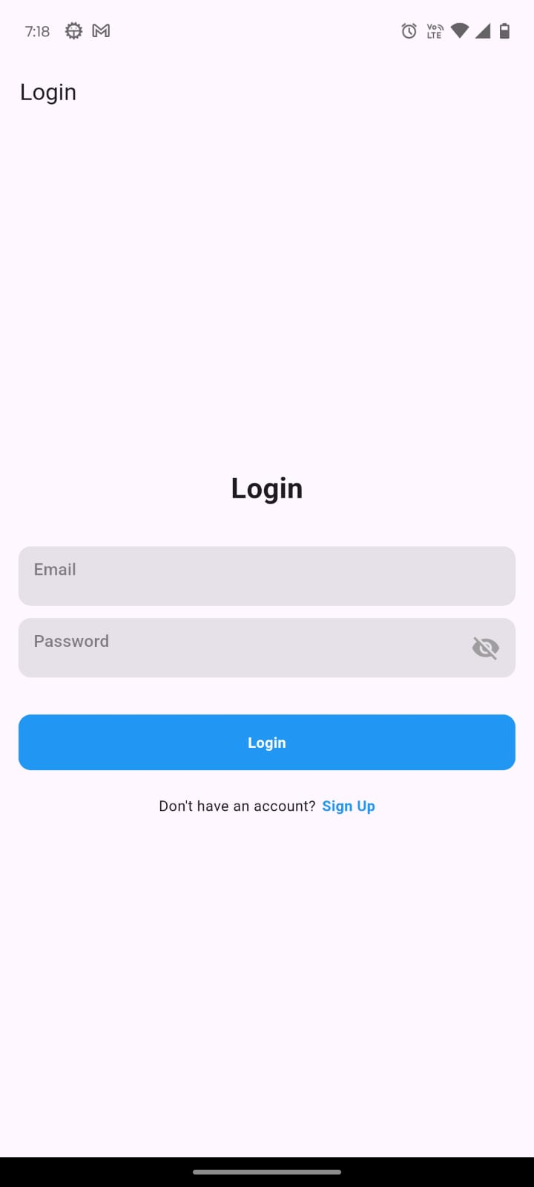
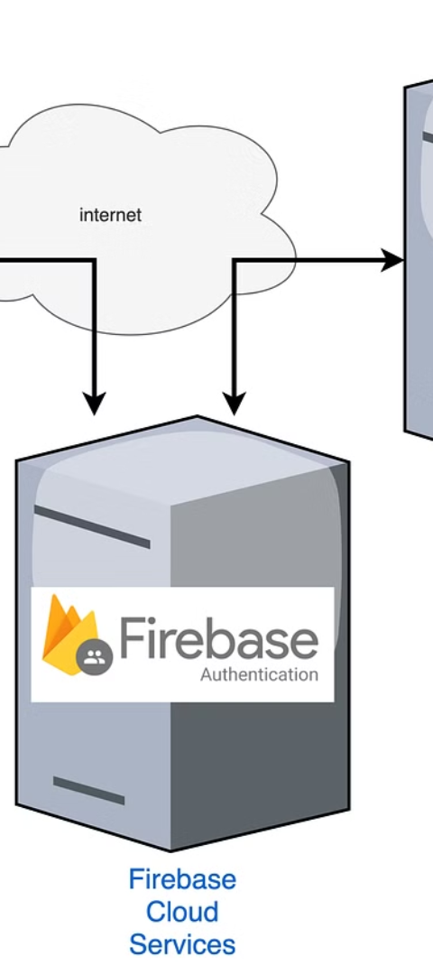
User Authentication
1
User Types
2
Firebase Authentication
The app supports two user types: Retail Managers and Employees, each with their own set of features and permissions.
The app utilizes Firebase Authentication to securely handle user sign-up, sign-in, and password management, ensuring a robust and reliable authentication system.
3
Sign-up and Sign-in Flows
Users can easily create new accounts or sign in to the app, with seamless integration of Firebase Authentication throughout the user journey.

Slide 4
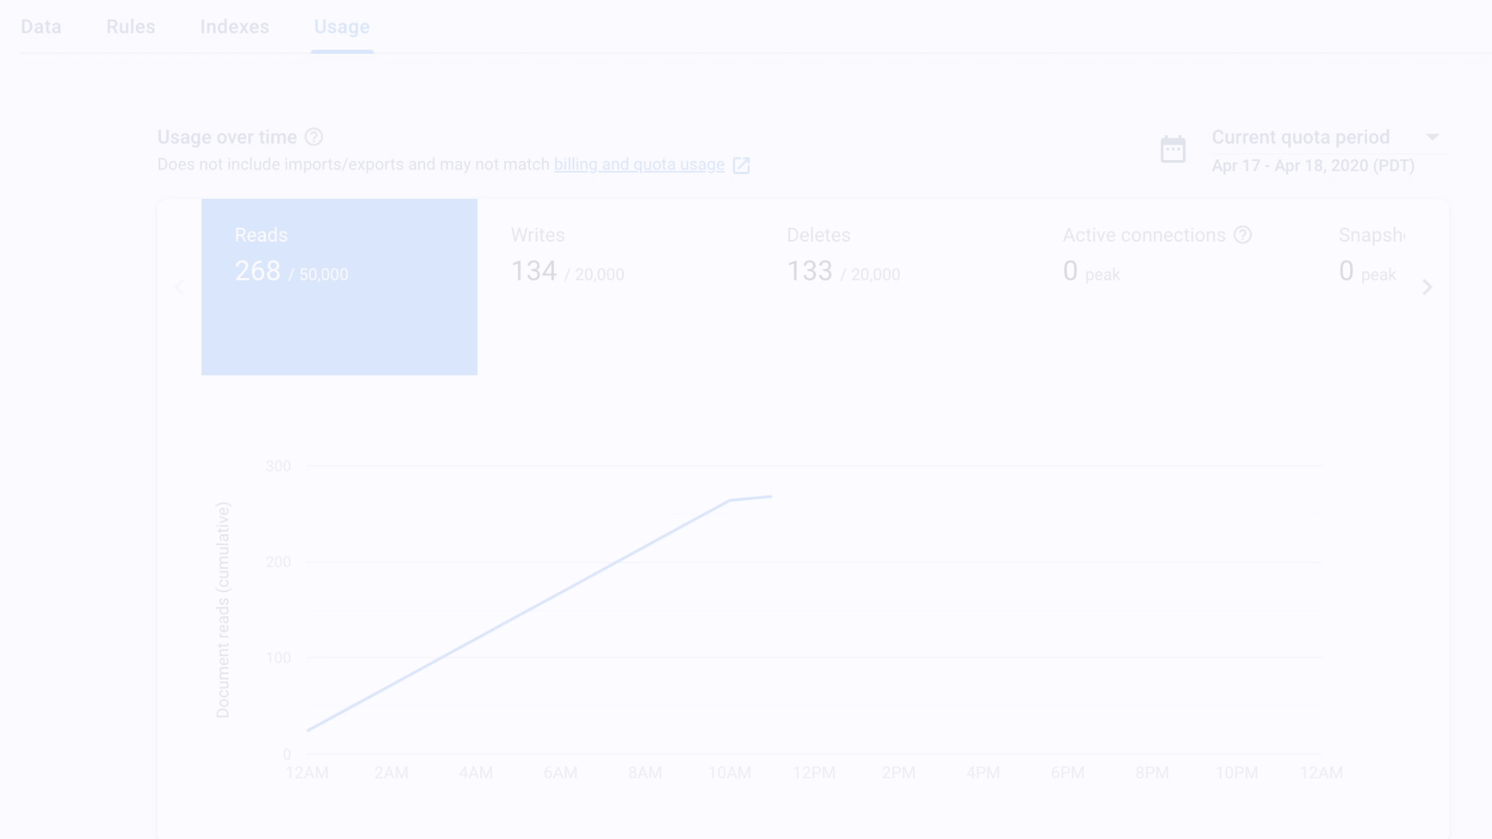
Manager Dashboard
Job Posting
Real-time Updates
Messaging
Retail Managers can post new job openings, providing details such as job title, description, category, and budget.
Job listings are stored and updated in real-time using Firebase Firestore, ensuring managers and employees always have access to the latest information.
Managers can communicate with employees through the app's built-in messaging functionality, facilitating seamless interaction and collaboration.

Slide 5
Employee Dashboard
Job Search
Job Application
Real-time Updates
Employees can browse and search for available job openings posted by Retail Managers, accessing detailed information about each opportunity.
Employees can apply for jobs directly within the app, streamlining the application process and allowing Managers to review and respond to applications efficiently.
Employees receive real-time updates on job postings, application status, and any changes to the job listings through the app's integration with Firebase Firestore.

Slide 6
Job Posting and Management
Job Posting
1
Retail Managers can create new job postings by entering details such as job title, description, category, and budget.
2
Firestore Integration
The job posting data is then stored and updated in real-time using Firebase Firestore, ensuring the latest information is available to all users.
Confirmation and Clearing
3
After successfully posting a new job, the app provides a confirmation message, and the input fields are cleared, ready for the next posting.

Slide 7




Real-time Communication
Messaging Between Users
Firebase Cloud Messaging
Reliable and Scalable
The FCM integration ensures that the app's real-time communication features are reliable, responsive, and can scale to support a growing user base.
The app enables real-time messaging between Retail Managers and Employees, facilitating seamless communication and collaboration.
The app leverages Firebase Cloud Messaging (FCM) to ensure that users receive instant notifications about new messages, job updates, and other important events.

Slide 8



Data Management with Firestore
Database Structure
CRUD Operations
Security Rules
The app's data is organized in a structured way within the Firebase Firestore database, with distinct collections for users, job postings, and messaging threads.
The app seamlessly handles Create, Read, Update, and Delete (CRUD) operations on the Firestore data, ensuring data integrity and consistency.
Firestore's security rules are configured to enforce appropriate access control and data permissions based on user roles and application requirements.

Slide 9

Login Page

Slide 10
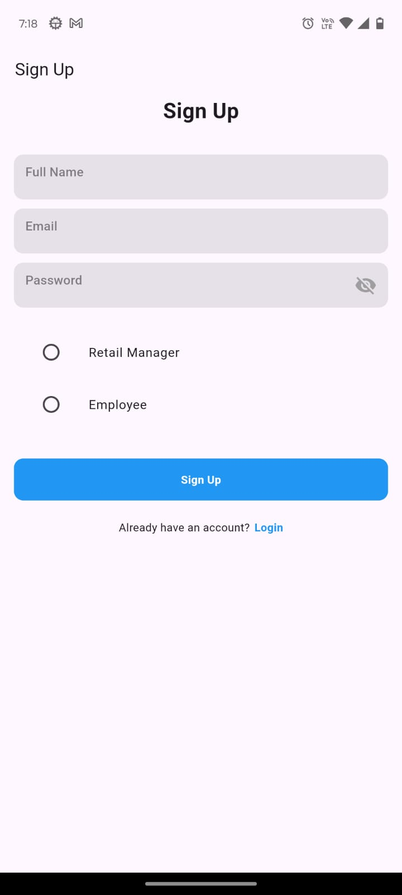
Sign-Up Page

Slide 11
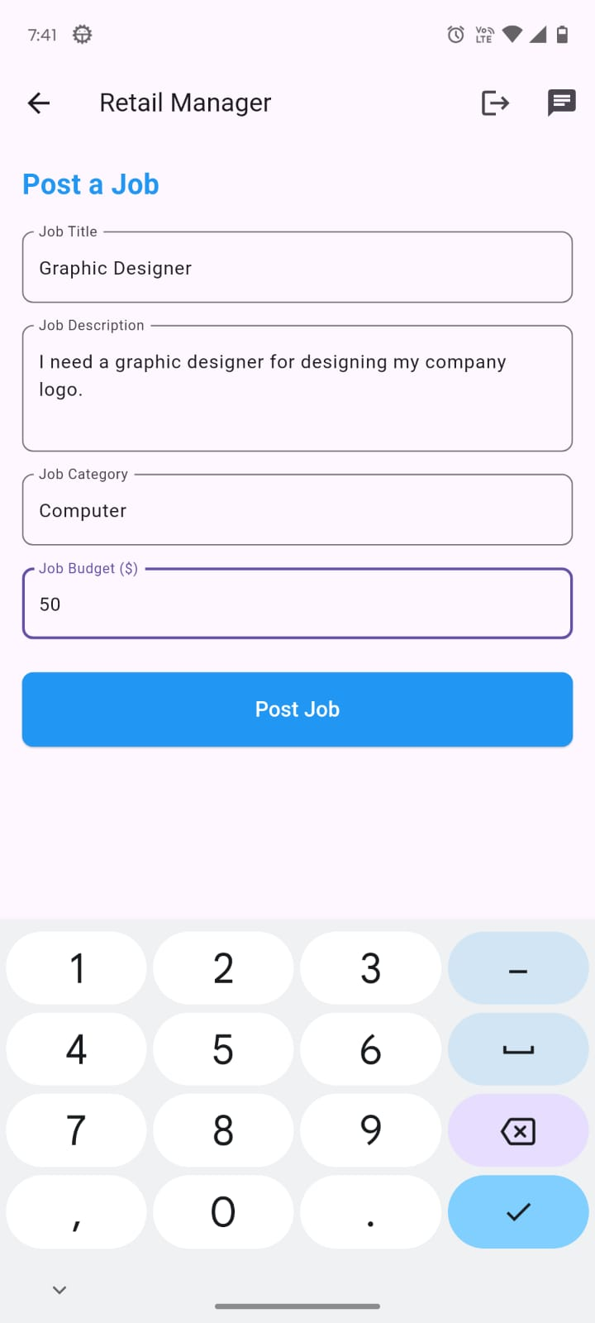
Retail Manager Home Page

Slide 12
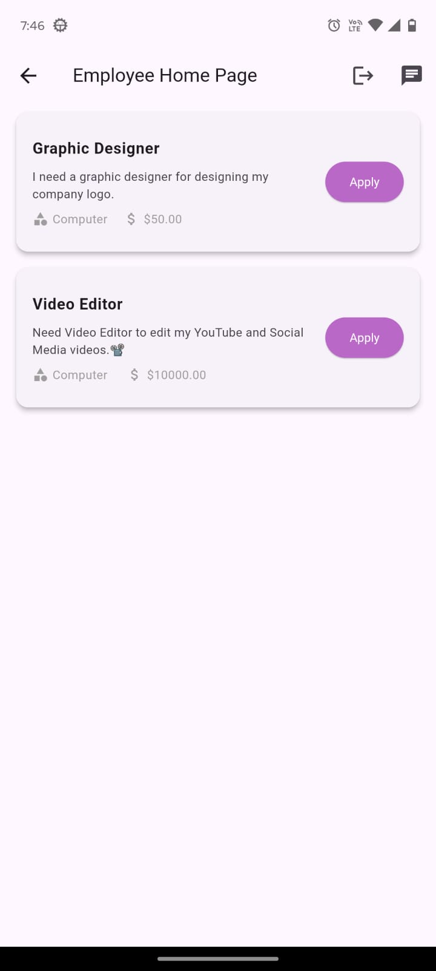
Employee Home Page

Slide 13
Challenges:
The main challenge was non-authorized people cannot access the account but, we faced the issue with it. Non-authorized people were also able to access the account.
And, User faced the issue during login process, by giving incorrect credentials or network issues which it leads to error in the page.

Slide 14


